Slide 1
Advisory Council Meeting
Graphic Arts Technology Program

Slide 2
Welcome!
Attendees:
Please fill out sign-in sheet
Online Attendees:
Please add your name, organization and position to the chat

Slide 3
Agenda
Introductions
Program Overview
Program Learning Outcomes
Courses for Review
GRD 415 | InDesign I
WDV 245 | Content Management Systems I
Questions for Discussion
High School Updates

Slide 4
Program Learning Outcomes
1. Prepare high quality images for output.
2. Control typography for various projects.
3. Demonstrate the ability to perform entry level job tasks in the graphic arts field.
4. Manage a graphic arts project from start to finish.
5. Work with clients to determine project needs.
6. Work with teams to achieve project goals.
7. Create a portfolio that demonstrates their abilities.

Slide 5
Program Overview
The Graphic Arts Technology Program at Clinton Community College provides training for students with an interest in developing the visual components of print. Our two-year program has a proven track record in providing students with the advanced, real-world skills needed to be successful.
Our classes and curriculum provide the core skills necessary for employment as a designer in the Graphic Arts, Marketing, and Advertising Industries. Throughout the program a strong emphasis is placed upon detail-oriented, on-time work. From day one students are placed into a team atmosphere where they learn constructive problem-solving techniques that can be applied to the everyday problems encountered in the industry.
In addition, our curriculum is designed to give students advanced skills in graphic design, packaging design, product design, prepress, and photography. Students entering their fourth semester create a professional portfolio.
Graphic Arts Technology, AAS | Print Track
2-year | Full Time
3-year | Part Time
Online (2022+)

Slide 6
Program Overview
The Graphic Arts Technology Program at Clinton Community College provides training for students with an interest in developing the visual components of front-end web development and social media. Our two-year program has a proven track record in providing students with the advanced, real-world skills needed to be successful.
Our classes and curriculum provide the core skills necessary for employment as a designer in the Graphic Arts, Marketing, and Advertising Industries. Throughout the program a strong emphasis is placed upon detail-oriented, on-time work. From day one students are placed into a team atmosphere where they learn constructive problem-solving techniques that can be applied to the everyday problems encountered in the industry.
In addition, our curriculum is designed to give students advanced skills in front-end web development, game design, graphic design, mobile app development, user experience (UX), web design, and photography. Students entering their fourth semester create a professional portfolio.
Graphic Arts Technology, AAS | Web Track
2-year | Full Time
3-year | Part Time
Online (2022+)

Slide 7
Program Overview
The diploma option for the Graphic Arts Technology Program at Clinton Community College provides training for students with an interest in developing the visual components for print or front-end web development.
Our classes and curriculum provide the core skills necessary for employment as a designer in the Graphic Arts, Marketing, and Advertising Industries. Throughout the program a strong emphasis is placed upon detail-oriented, on-time work. From day one students are placed into a team atmosphere where they learn constructive problem-solving techniques that can be applied to the everyday problems encountered in the industry.
Students may earn the diploma after one year then later choose to complete the second year with more on-hands projects to earn the AAS.
Graphic Arts Technology, Diploma
1-year | Full Time

Slide 8
Program Overview
Many professionals are often expected to be able to pick up a Digital Single Lens Reflex (DSLR) camera or its equivalent and
produce images for art, marketing, journalism, research, etc. The Photography Certificate option for the Graphic Arts Technology Program at Eastern Iowa Community Colleges provides supplemental training for students with an interest in adding professional photography skills that help students differentiate themselves when competing for jobs in the marketplace.
This certificate is appropriate for anyone interested in the study of photography. Students in the AAS in Graphic Arts Technology program can complete the certificate with the addition of two classes and only minor adjustments to their schedules.
Graphic Arts Technology — Digital Photography, Certificate
1-year | Full Time
Online (2022+)

Slide 9
Courses for review
Efficiently utilize a page layout software program to complete all computer-based assignments.
Apply basic design principles.
Choose appropriate typography solutions.
Demonstrate the appropriate use of images and color in design solutions.
Evaluate completed project.
GRD 415 | InDesign I
Student Learning Outcomes

Slide 10
Courses for review
Utilize content management system software to set up and configure a database driven website.
Utilize a front-end developer framework to customize the appearance and behaviors of a CMS.
WDV 245 | Content Management Systems I
Student Learning Outcomes

Slide 11
Questions for discussion:
•
How can our CTE programs better prepare students for jobs in your industry?​

Slide 12
Questions for discussion:
•
What are the emerging occupations in your industry to which students should be exposed?​

Slide 13
Questions for discussion:
•
What opportunities exist in your industry for English learners or students with disabilities?​

Slide 14
Questions for discussion:
•
What are some emerging technology trends that you are seeing in your industry that may require new skillsets for workers?

Slide 15
High School Updates
We invite our high school partners to share updates on their CTE programs.
EICC partners with local high schools to offer college courses to high school students. These courses may be taught by high school instructors or EICC faculty, either at the high schools or on the EICC campus. Many students also participate in EICC career academies.
These opportunities allow students to earn certificates leading directly to employment or complete coursework that prepares them for college transfer—while providing significant cost savings for students and families.

Slide 16
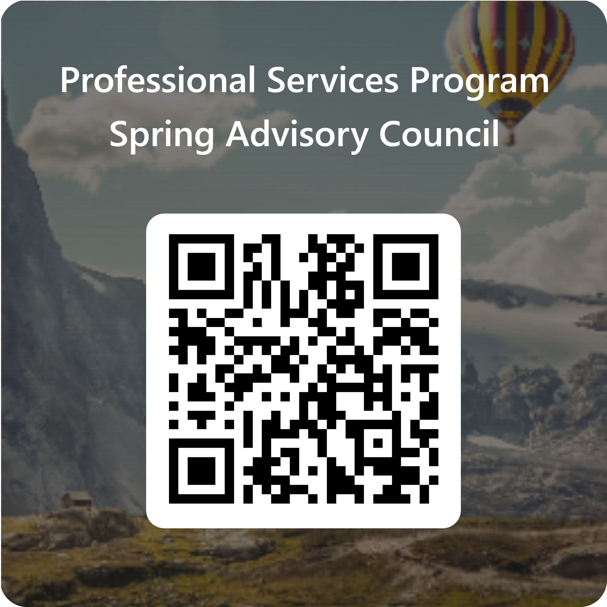
Thank you!
Before leaving, please fill out this brief survey

